Slide 1
VAIGAI COLLEGE OF ENGINEERING, MADURAI – 600 025
DEPARTMENT OF COMPUTER SCIENCE AND ENGINEERING
“CYBER HACKING BREACHES PREDICTION AND DETECTION USING MACHINE LEARNING ”
TEAM MEMBERS :
BALA VISHWATHARAN G | 913320104013
AMEED HARSAI U | 913320104006
SRI RAM MAHADEVAN S | 913320104049
VISHVA J | 913320104055

Slide 2
ABSTRACT :
The "Detection of Cyber Crime Breach using Machine Learning" project aims to develop a proactive solution for identifying and forecasting cyber crime breaches. By combining time series analysis with SARIMAX modeling, the project analyzes historical cyber crime data to forecast future breach occurrences. Innovative methodologies for data preprocessing, feature engineering, and model optimization enhance accuracy and reliability compared to existing systems. The project offers customizable solutions tailored to different organizational needs and provides cost-effective alternatives to proprietary systems. Rigorous evaluation tests and real-world case studies demonstrate superior performance in enhancing cyber security measures and empowering organizations to stay ahead of evolving threats.

Slide 3
INTRODUCTION :
In today's networked world, the threat of cyber attacks looms large, fuelled by sophisticated automated technologies.
Malicious software, particularly targeting embedded systems like IoT devices, poses a significant challenge due to its evolving complexity.
Traditional signature-based defence are inadequate against the diverse range of modern malware.
Human involvement alone is insufficient to handle the vast volume and dynamic nature of cyber threats.
Integration of machine learning is crucial, enabling the analysis of large datasets to detect patterns and predict security concerns effectively.
An example of machine learning application is in identifying phishing websites, showcasing its role in proactive threat detection.

Slide 4
EXISTING SYSTEM :
● Security Information and Event Management(SIEM).
● Anti-Malware Software.
● Threat Intelligence platforms.
● Forensic Analysis Tools.
● Behaviour Analytics Tools.

Slide 5
EXISTING SYSTEM LIMITATIONS:
LIMITATIONS:
Time consuming.
Pattern Matching.
Statistical Analysis.
Dynamic analysis.
Expertise Required.

Slide 6
LITERATURE SURVEY:
In recent years, the proliferation of digital technologies has revolutionized the way individuals and organizations interact, communicate, and conduct business.
However, this digital transformation has also given rise to new and sophisticated forms of criminal activity known as cybercrime.
Cybercriminals exploit vulnerabilities in computer systems, networks, and software to steal sensitive information, disrupt services, and cause financial harm increasing frequency and severity of cyberattacks have underscored the urgent need for effective strategies to detect, prevent, and mitigate cyber threats.
The field of cybersecurity encompasses a wide range of disciplines, methodologies, and technologies aimed at safeguarding digital assets and protecting against cyber threats.
One area of particular interest is the use of machine learning techniques for cybercrime detection and prediction.

Slide 7
Machine learning leverages algorithms and statistical models to analyze large volumes of data, identify patterns, and make predictions without explicit programming instructions.
In the context of cybersecurity, machine learning offers a promising approach to enhance the capabilities of traditional security systems and address the evolving nature of cyber threats.
This literature review seeks to provide a comprehensive overview of existing research on cybercrime detection and prediction using machine learning. By synthesizing findings from previous studies and examining current methodologies and approaches, this review aims to identify key trends, challenges, and opportunities in the field.
The review will cover various aspects of cybercrime detection and prediction, including the types of machine learning algorithms used, evaluation metrics and performance benchmarks, challenges and open research questions, and future directions for research and innovation.

Slide 8
PROPOSED SYSTEM:
The SARIMAX model is initialized, fitted to the time series data, and used to generate forecasts of cyber crime breaches.
The proposed system consists of several key components, including data collection, preprocessing, time series analysis, model implementation, and evaluation.
The performance of the forecasting model is evaluated using metrics such as Mean Squared Error (MSE), Root Mean Squared Error (RMSE), and Mean Error (ME) to assess its accuracy and effectiveness.
The proposed system enables early detection of cyber crime breaches by analysing historical data and identifying potential patterns or trends indicative of future breaches.

Slide 9
PROPOSED SYSTEM ADVANTAGES:
ADVANTAGES:
Adaptability.
Efficiency.
Accuracy.
Predictive Capabilities.

Slide 10



ARCHITECTURE :
Organization
Model for
training
Breached
Social Network
Data
preprocessing
Prediction
Not Breached
Websites

Slide 11
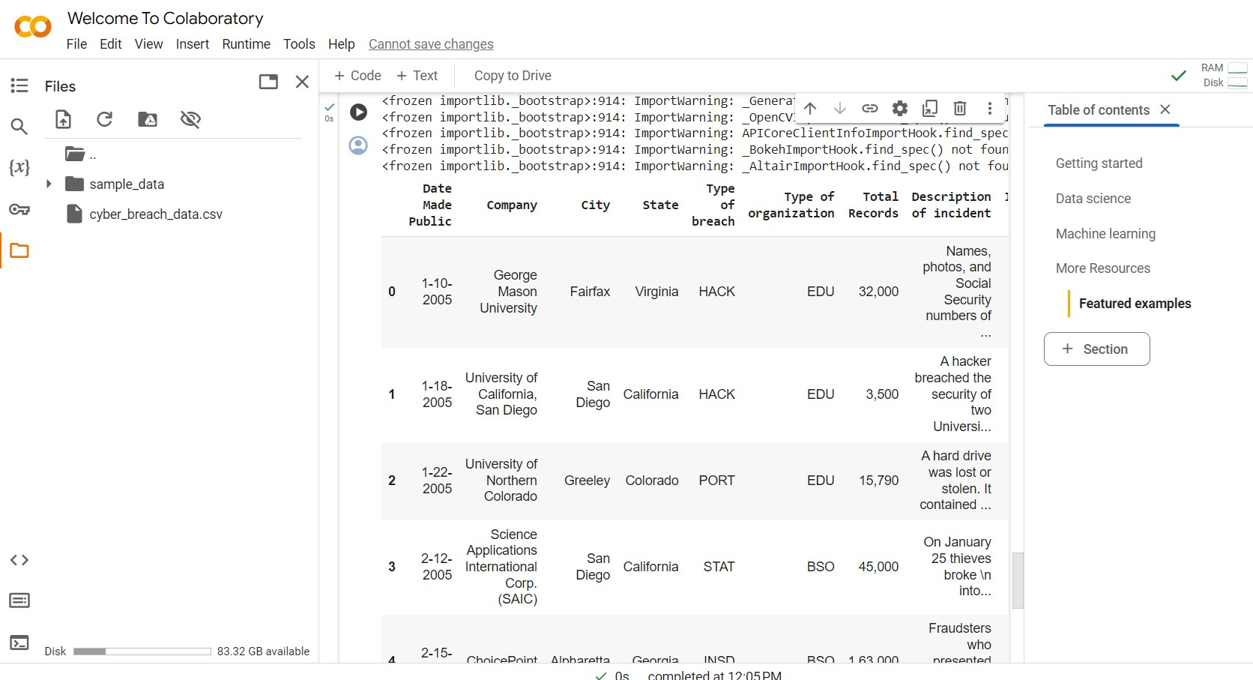
PARTIAL OUTPUT :

Slide 12
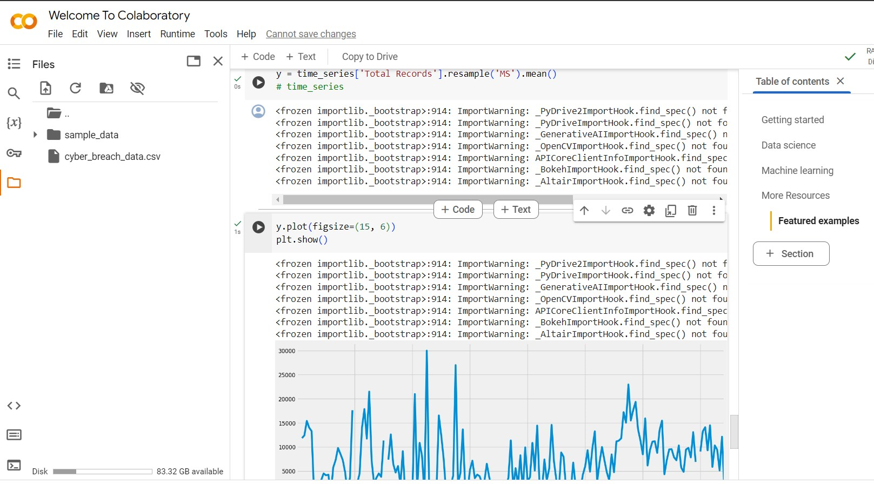

Slide 13
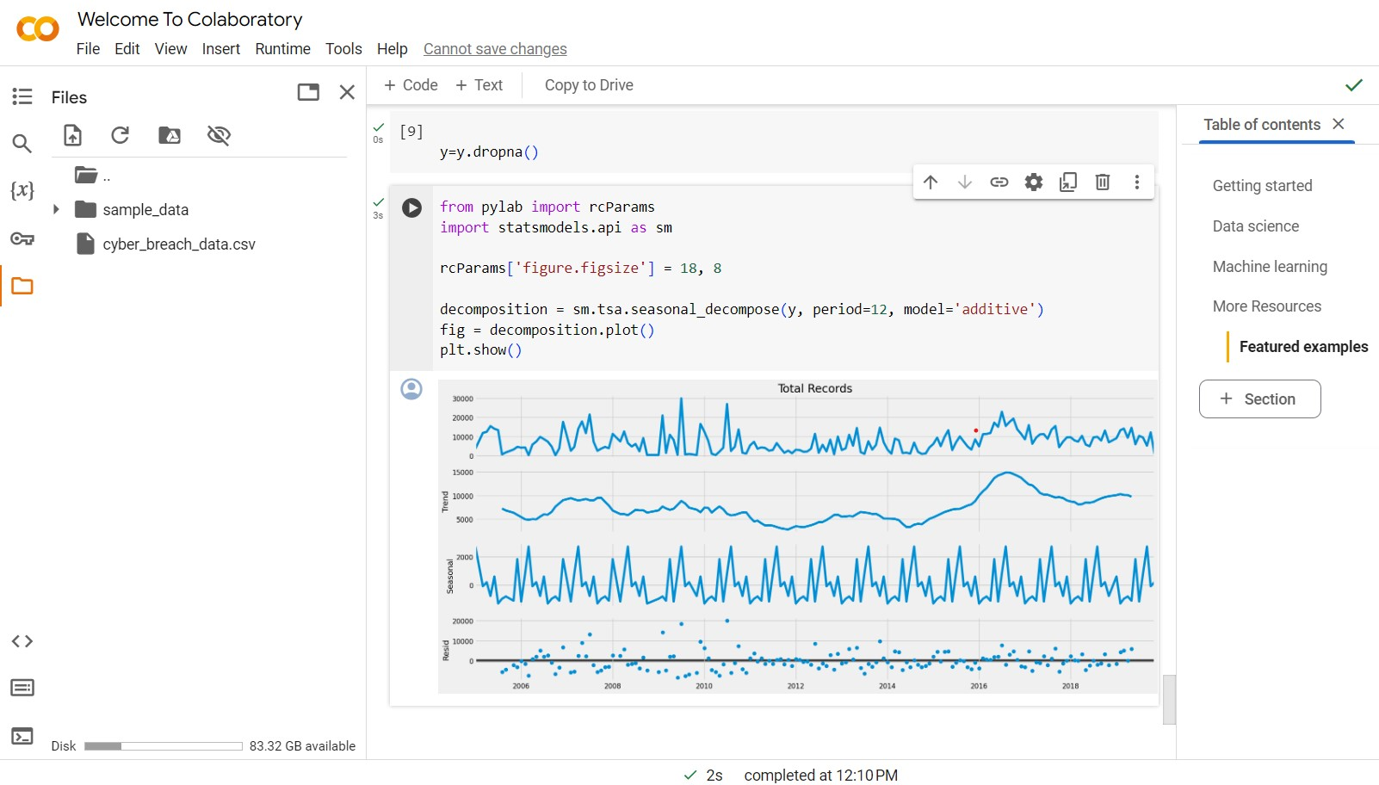
FINAL OUTPUT :

Slide 14
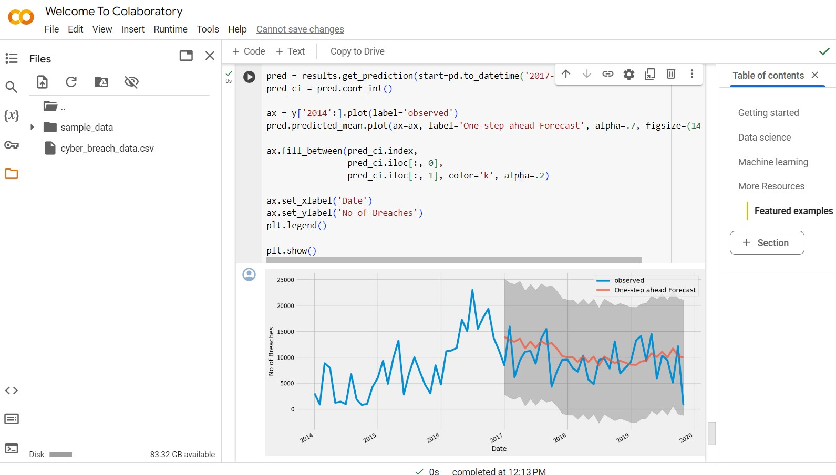
METRIC VALUES:
The Mean Squared Error of our forecasts is 14725803.05
The Root Mean Squared Error of our forecasts is 3837.42
Mean Error: 1394.8847794482656

Slide 15
CONCLUSION:
In conclusion, the endeavour to detect cybercrime breaches using machine learning techniques represents a pivotal step forward in the realm of cybersecurity. It is evident that malware attacks pose significant threats to computers, potentially causing numerous problems and issues. Hence, the imperative lies in both detecting and promptly removing malware from systems to ensure overall protection. The primary objective of this research is to employ machine learning techniques for the detection of malware samples within computer systems. When executed with stringent constraints, proper malware detection should ideally yield a false positive rate of zero, thereby bolstering system security. The "Detection of Cyber Crime Breach using Machine Learning" project represents a significant advancement in the field of cyber security. By leveraging advanced machine learning techniques, particularly SARIMAX modelling, this project offers a proactive solution for detecting and forecasting cybercrime breaches.

Slide 16
REFERENCES:
E. Gandotra, D. Bansal and S. Sofat, "Malware analysis and classification: A survey", Journal of Information Security, vol. 5, no. 2, pp. 56-64, 2014.
W. Hardy, L. Chen, S. Hou, Y. Ye and X. Li, "DL4MD: A deep learning framework for intelligent malware detection", International Conference on Data Mining (DMIN), 2016.
A. Shalaginov, S. Banin, A. Dehghantanha and K. Franke, "Machine learning aided static malware analysis: A survey and tutorial", Cyber Threat Intelligence, pp. 7-45, 2018.
M. Sikorski and A. Honig. “Practical Malware Analysis”. Published by No Starch Press, Inc.38 Ringgold Street, San Francisco, CA 9410, 2012.
Microsoft Malware Classification Challenge, Kaggle, 2015. [Online], available at https://www.kaggle.com/c/malware-classification.

Slide 17
M. Egele, T. Scholte, E. Kirda and C. Kruegel, "A Survey on Automated Dynamic MalwareAnalysis Techniques and Tools", Journal in ACM Computing Surveys, vol. 44, 2012.
S. Anderson and P. Roth. “EMBER: An Open Dataset for Training Static PE Malware”, arXiv, 1804.04637,2018.
T. Morgenstern. “Malware Terms for Non-Techies Code Entropy”, 2016. [Online], available at https://www.cyberbit.com/blog/endpoint-security/ malware-terms-code- entropy/.
“Hunting for Malware with Machine Learning”. EndGame, 2016
Y. Ye, T. Li, S. Zhu, W. Zhuang, E. Tas, U. Gupta, et al., "Combining File Content and File Relations for Cloud Based Malware Detection", Proceedings of ACM International
R. Ronen, M. Radu, C. Feuerstein, E. Yom-Tov and M. Ahmadi. “Microsoft Malware Classification Challenge”, arXiv, 1802.10135, 2018

Slide 18
J. Kolter and M. Maloof, "Learning to Detect Malicious Executables in the Wild", Proceedings of the 10th ACM SIGKDD International Conference on Knowledge Discovery and Data Mining, pp. 470-478, 2004.
A. Damodaran, F. D. Troia, C. A. Visaggio, T. H. Austin, and M. Stamp. “A comparison of static, dynamic, and hybrid analysis for malware detection”, Journal of Computer Virology and Hacking Techniques, vol. 13, no. 1, pp. 1–12, Dec. 2015.
R. Tian, L. Batten and S. Versteeg, "Function Length as a Tool for Malware Classification", Proceedings of the 3rd International Conference on Malicious and Unwanted Software, pp. 57-64, 7 - 8 October 2008.
Manal Abdullah, Afnan Agal, Mariam Alharthi and Mariam Alrashidi. Arabic Handwriting Recognition Model based on, International Journal of Advanced Trends in Computer Science and Engineering, Vol. 8, No.1.1 2019

Slide 19
R. Tomar and Y. Awasthi. “Prevention Techniques Employed In Wireless Ad- Hoc Networks”. International Journal of Advanced Trends in Computer Science and Engineering, Vol. 8, No.1.2, 2019
A. Sung, J. Xu, P. Chavez and S. Mukkamala, "Static analyzer of vicious executables (save)", Proceedings of the 20th Annual Computer Security Applications Conference (ACSAC ’04), vol. 00, pp. 326-334, 2004.

Slide 20
THANK YOU !!!

